Slide 1
Changing Library in Changing University of Latvia: 2015/2016
Seminar “Preservation, Research and Communication of Cultural Heritage”,
Vilnius, 9 May 2016
Notes:
Dear colleagues and friends.
First of all, on behalf of my group I would like to say how much we are glad to be here and meet . Even more - not only to meet, but get new knowledge and a sense of the shoulder for further work.

Slide 2
Changing university
2015/2016
study and research quality
engagement with the society
development of academic staff and specialists
new management action program
consolidation of scientific institutes
Notes:
This teaching year is the beginning of big changes in our university. We have a new rector, new leadership, new development program.
I will mention a few points from new directions.
study and research quality
engagement with the society
development of academic staff and specialists
new management action program
consolidation of scientific institutes
The library within its competencies is actively engaged In each of the directions of university development.

Slide 3
Changing library
2015/2016
involvement in development of study programs: adequacy of information resources
management of research evaluation system
preserve the intellectual and cultural heritage and open access
change positions moving towards a stronger scientific activities
inclusion of scientific institutes in joint user services system
Notes:
I want to highlight some of the changes
there is an active study program review and cross coordination, where the role of the library is growing. Library is not only providing information resources, but also evaluating and giving recommendations.
It has launched the scientific achievements process compiling in the information system, so that this data will be provided to any administrative actions and publicity. The reliability of publications be checked by library specialists and added value.
Digitization of valuable historical collection has been launched. One after the other available at open access repository of university. Concerning certain rarities my colleagues will speak more during the seminar. And also we are going to digitization of card catalog – it means that full collection of library will be available online.
This year we have started to change some personal positions. First step: all librarians as teachers assimilated carry out the teaching activities. Second: we have a new position: expert. Their work is based on a research project management related to research of collection and access to university research. All four new experts are here and you can personally ask about their work. And now we are going to researchers staff in our library.
Many research institutes have been consolidated in university structure. Scientists gets used to the library services, especially services for them: book delivery, individual trainings.

Slide 4


Functional structure
Head of administration
Library at Aspazijas Boulevard
Library at Kalpaka Boulevard
Library council
Library at Raina Boulevard
Director of the Library
Library of Natural Sciences
Deputy director
Executive director
Library of the Faculty of
Physics and Mathematics
Collection development
department
User service department
Library of the Humanities
Library of Education Sciences
and Psychology
Libraries
Library of the Faculty of
Social Sciences
Notes:
About changes in library management.
Library boss is now the head of administration, because there is no more vice-rector for science. University has three vice-rectors responsible for defined areas of science.

Slide 5
Main statistics data (2015)
Visitors 458 506
Conferences 3
Users 17 085
Exhibitions 23
Loans 536 216
Educational events 325
Projects 4
E-books 142 182
Compiled bibliographies 5
E-journals 38 991
Number of publications 10
Databases 177
Notes:
also 2015 Statistics show the use of the library service stability despite of the decreasing number of students.

Slide 6

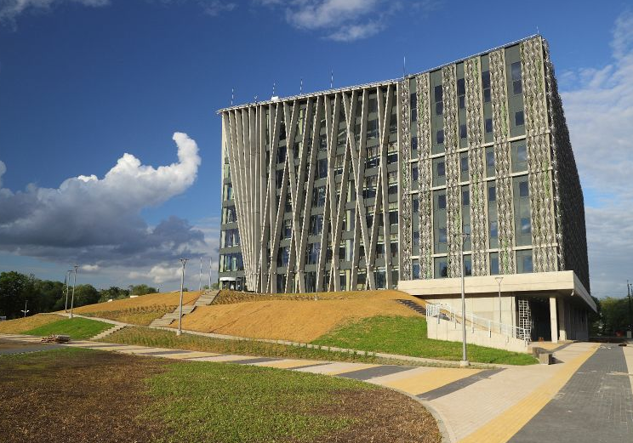
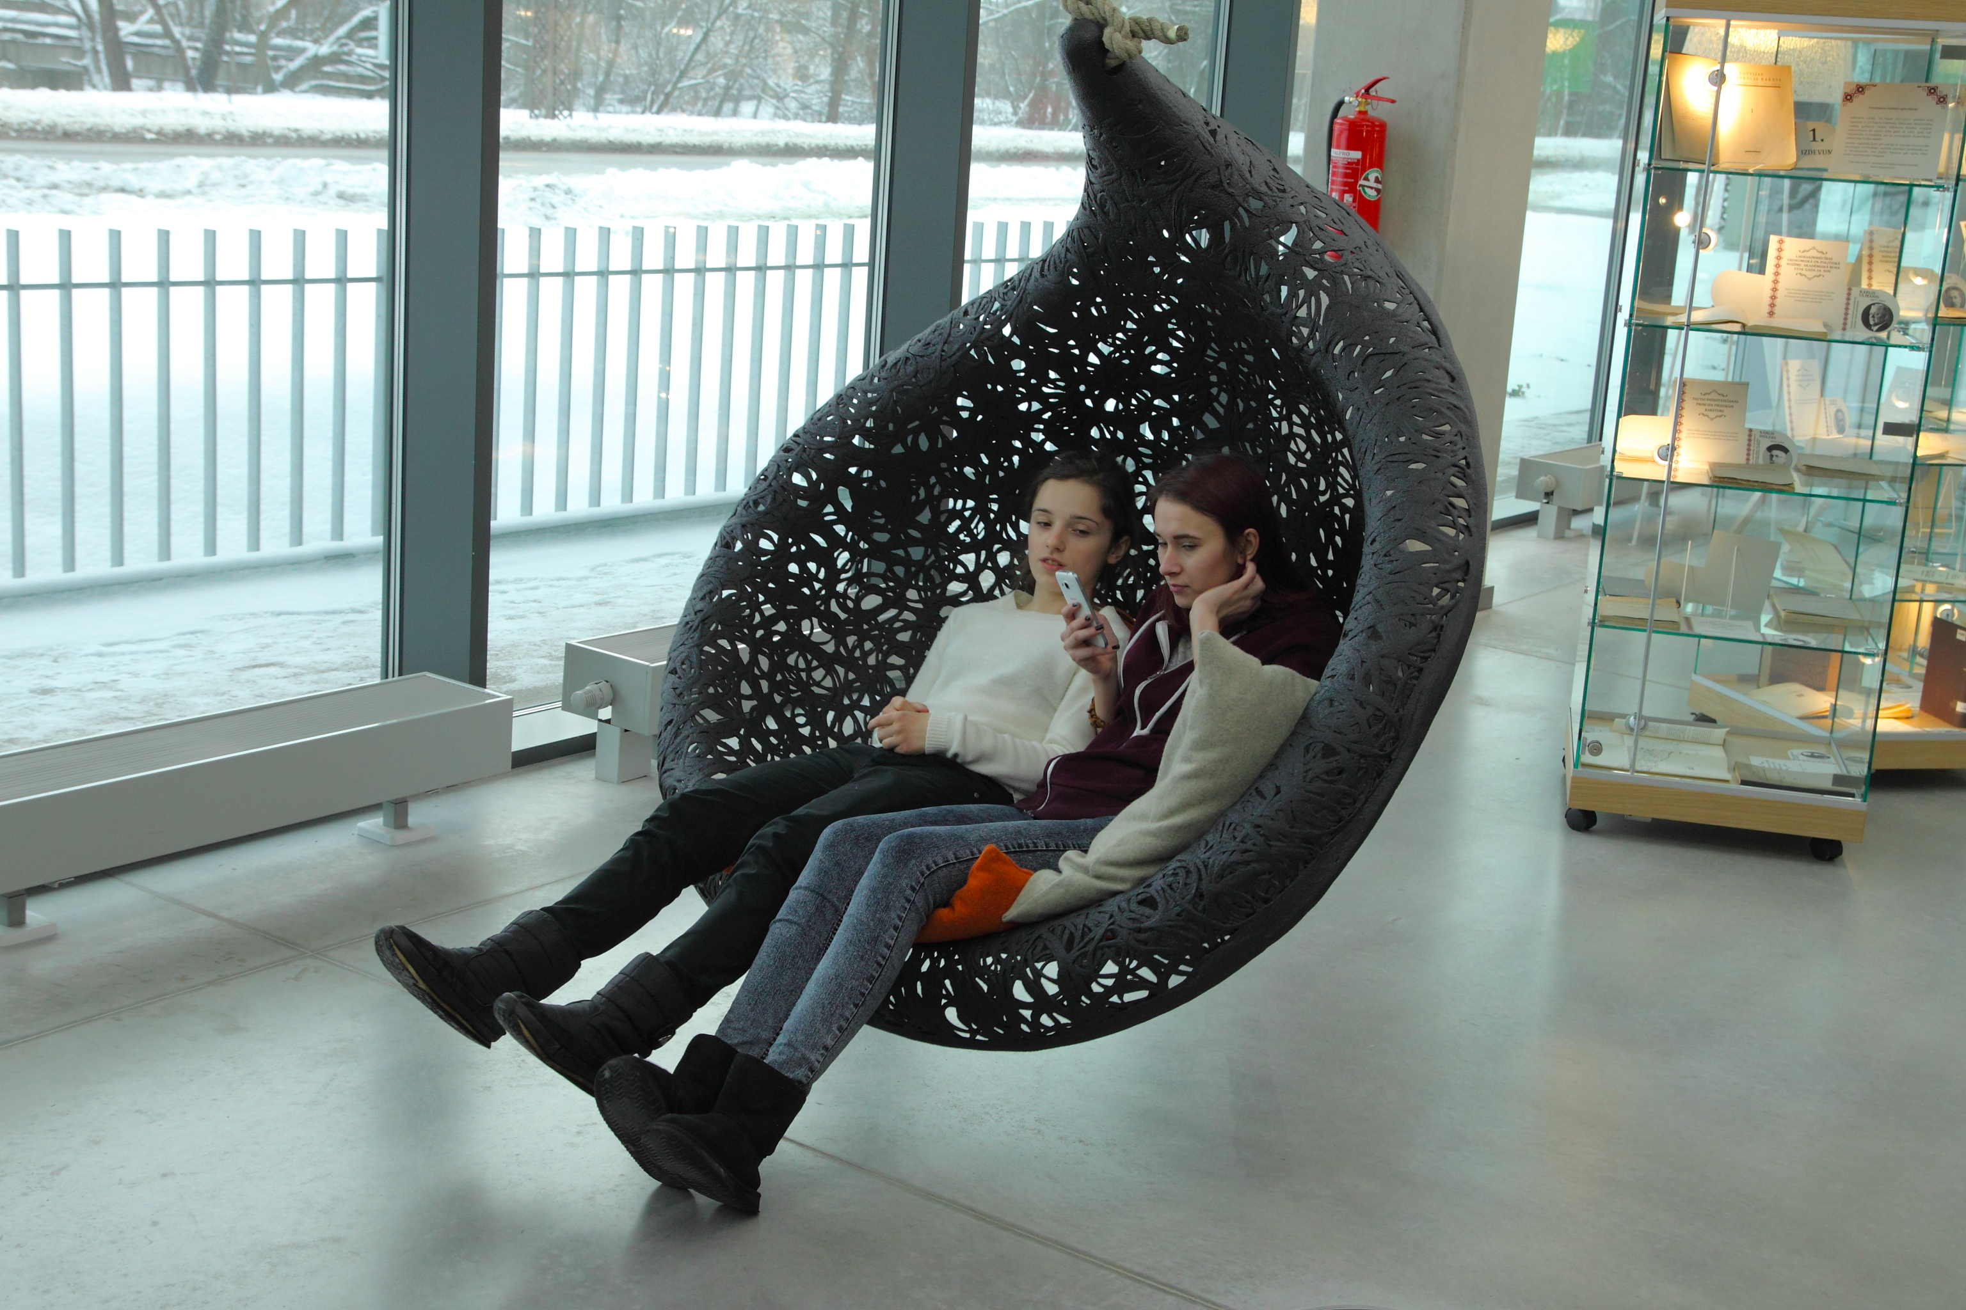
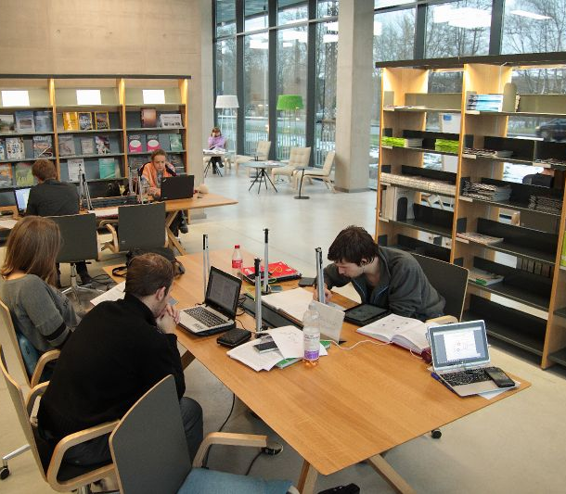
Library of Natural Sciences
Beginning of new University campus
Notes:
About the new project of the Universty of Latvia – the Campus. The first stage is a Centre of Natural Sciences, a modern centre of knowledge and new technologies. The first stage of the project completed in August 2015. We call this building on the natural house. The new building is going to accommodate four faculties: Faculty of Biology, Faculty of Chemistry, Faculty of Geography and Earth Sciences, and Faculty of Medicine, as well as the Institute of Microbiology and Biotechnology and Institute of Chemical Physics. There we integrated 3 branch libraries.
As a result we have:
24/7 Open and accessible open space library without doors
Only actual and always available collection of books
A library without a librarian after contact working hours 6 day a week
New technologies for selfservice and individual work
Planned resource delivery between branch libraries
Modern security everywhere in house
but next year you will find out more when we will organize a seminar directly in this building.

Slide 7
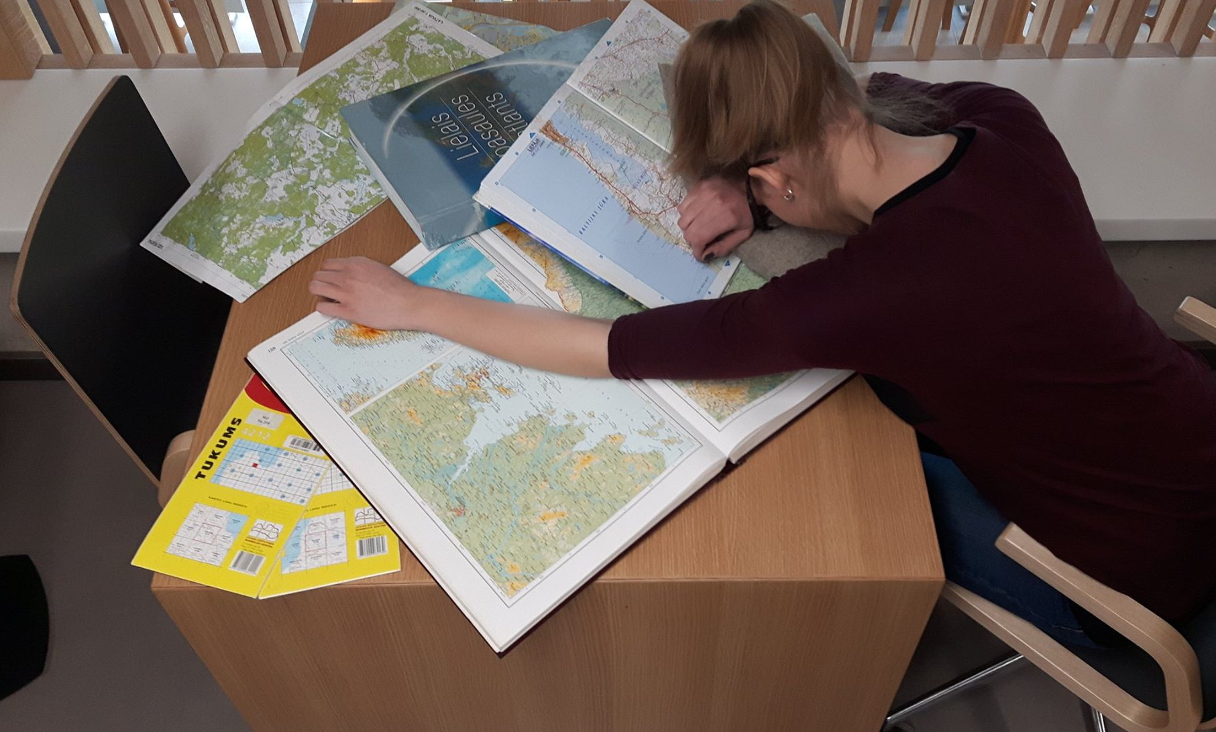
Thank you for attention
Notes:
I hope that for more students time spending in library will be their new lifestyle!

